Slide 1

RESUME BUILDER WEBsite
An
Presentation on
AKS UNIVERSITY SATNA
Department of computer science & Engineering
GUIDED BY
Mr. Vinay Dwivedi
SUBMITTED BY
Ayush Rajak
Std.code- B2155R10106082

Slide 2
Table of content
INTRODUCTION
TECHNOLOGY USED
WEBSITE FEATURES
OBJECTIVES
SCOPE RELEVANCE
PROJECT SNAPSHOTS
OUTPUT
CONCLUSION & FUTURE ASPECTS

Slide 3
INTRODUCTION
Creating a resume is a bit tedious task for any working professional from any industry. One has to keep it short, simple, with the latest work experience and constantly update it over a while. It is application that simplifies the task of creating a resume for indivisuals. The system is flexible to used and reduces the need of thinking and designing an according to qualifications.

Slide 4
Technology Used
HTML
CSS
JAVA SCRIPT
BOOTSTRAP V5

Slide 5
Project Features
Flexible text editor
free pdf download
Easy to shares
You can costemized your resume
Free of cost
User friendly interface

Slide 6
OBJECTIVE
The main objective of the resume builder is to manage the details of resume ,jobs, individual, skills, qualification. It manages all the information about resume, jobseeker, qualification, resume.
The answer provided by the user are stored and the system automatically
generates a well structured resume

Slide 7
SCOPE
Resume can also be classified according to different branches and for Specific companies.
Resume Builder is to provide a way to the customers to design their resumes according to their requirements.

Slide 8
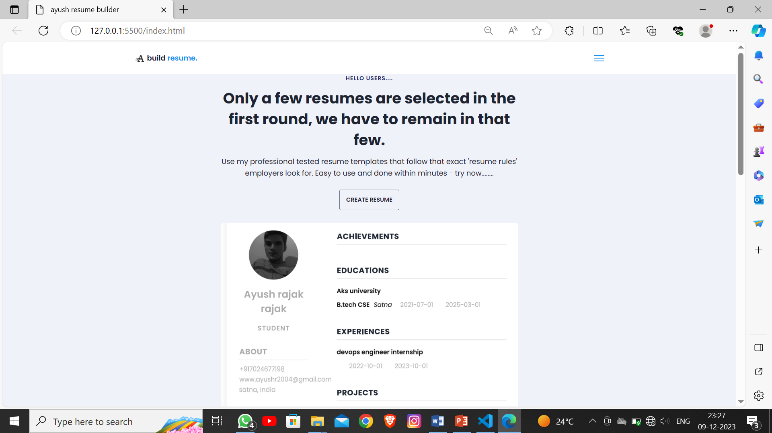
website SNAPSHOT
Snapshot.1: Home page of web application

Slide 9
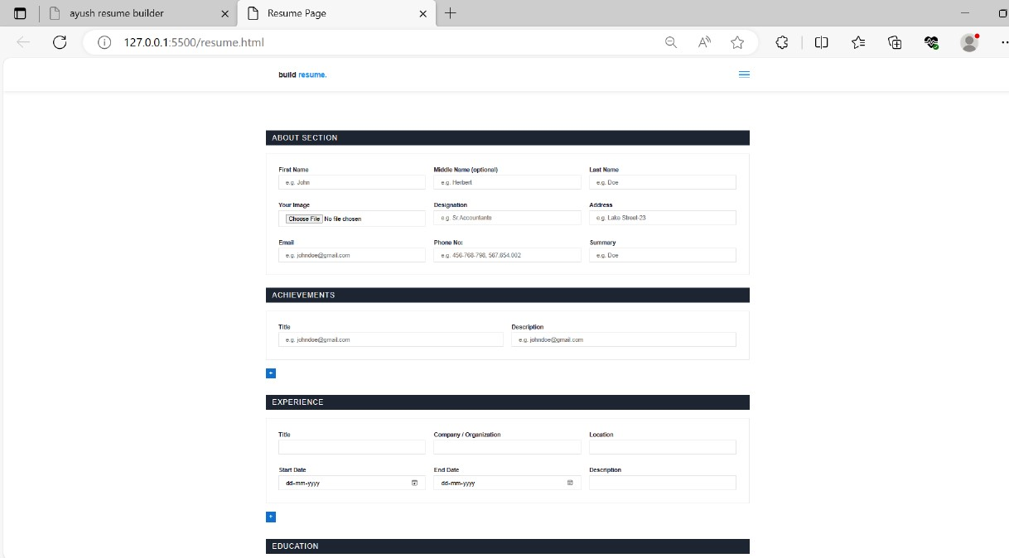
Snapshot.2: resume builder input page.

Slide 10
CONCLUSION
The online resume builder is one of the most fantastic system for the people who are either recently graduated students in their domain or id they don’t have enough idea about the resume or don’t have enough time to create the resume of good designs or patterns.

Slide 11
THANK YOU…..

